Slide 1
Azure AI – Day1

Slide 2
Azure AI Ecosystem Technical Deep Dive –Day 1
Sashank Pappu
Azure Data & AI Specialist

Slide 3


Sashank Pappu
Azure Data & AI Specialist.
Certified from MIT on ‘Advanced Analytics and Big Data Challenges’. Technology Enthusiast and Data Specialist. Certified Designer in Computer Vision
• Microsoft Certified Power BI Developer. • Microsoft Certified Azure Machine Learning Developer from Microsoft Virtual Academy • Certified on Practical Data Analytics with Microsoft Cortana Intelligence Suite.
9+ years of total experience as Data Specialist and Data Engineer.
Certifications
Experience
Currently working as Independent Consultant on Azure Data & AI and Enterprise Trainer on Azure Data Analytics , Cortana Intelligence Suite and Cognitive Sciences
Expert facilitator and corporate behavioral trainer with 5 years of experience in designing programs, content development , Data Analytics and Machine Learning.
Role
Training
Sri Nag Sashank
You can see me on – Sashankpappu.com

Slide 4
Day 1 - AI
Azure AI Ecosystem
Azure AML Studio
Azure ML Services
Azure AutoML

Slide 5
Day 2 - AI
Azure Databricks
Azure Machine Learning Services
Deployment into Containers
Use case on Custom AI & Cognitive Services

Slide 6
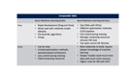
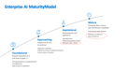
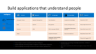
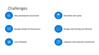
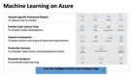


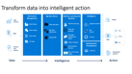
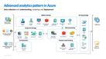
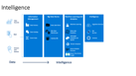
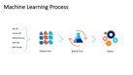
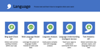
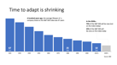




Slide 7
AGENDA
Overview of Machine Learning Offerings
10-11 : AML Studio Intro & Hands on Deployment
11-11:15: BREAK!!!
11:15-1 : AML Studio - Labs Hyper Tuning
1-2 : LUNCH
2-3:15 : Auto ML Intro
3:15-5 : Hands on Azure AutoML

Slide 8

Insights is a journey
Insight
What happened?
Why did it happen?
What will happen?
What should I do?
Reports
Interactive
Dashboards
Predictive
Models
Recommendations
& Automation
Notes:
While data is pervasive, actionable intelligence from data is elusive. We understand that customers want to transform data to intelligent action and reinvent their business processes. To do this they need to more easily analyze massive amounts of data – so they can move from seeing “what happened” and understanding “why it happened” to predicting “what will happen” and ultimately, knowing “what should I do”. Only then can they create the intelligent enterprise and accelerate digital transformation.
Put another way, the journey to greater insight involves moving from “forensic” or “descriptive” analytics – use of historic measurement to describe what happened and why – to more advanced analytics that become “predictive” and eventually “prescriptive”.
This journey is a natural evolution as an organization leverages data more thoroughly. We think about it in 4 steps:
Step 1: What happened?
Utilize descriptive analytics to understand what happened
Step 2: Why did it happen?
Incorporate diagnostic analytics for a better understanding of why certain things happened in the past, making it possible to better identify root causes
Step 3: What will happen?
Expand into predictive analytics: With sufficiently detailed historical data and the rigorous application of statistical methods including machine learning, we can now predict a variety of events and effects that could not accurately be forecast in the past.
Step 4: What should I do?
Use prescriptive analytics for foresight: Foresight is the holy grail of analytics. By analyzing a set of reactions, we can not only predict what will happen, but how various responses will fare, given individual conditions, people, etc. It requires not only that we predict, but that we measure the individualized results of actions taken in the past, like medical treatments for particular patient cohorts, and then measure the effectiveness of past actions in prescribing how to react in the future. We can then automate action based on the prescriptive analytics, delivering business value directly in the flow of daily business activities.

Slide 9
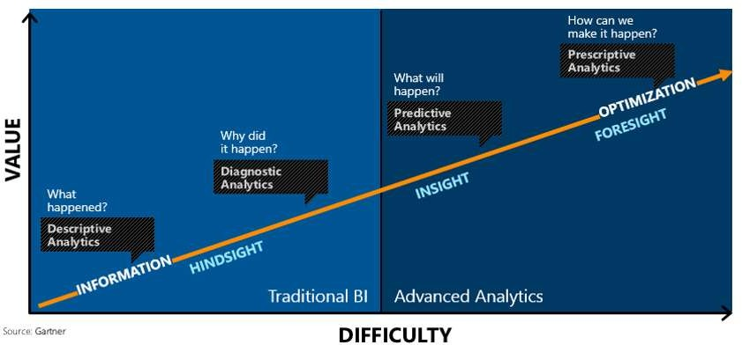

Slide 10




Enterprise AI Maturity Model
Mature
Emerging data science
and operational capability
Understands model lifecycle
Building a foundational data architecture
Aspirational
Experimented and applied AI
High digitization
Desires new business models Achieved a data culture
Approaching
Hopeful on AI and its promise
Digitization underway
Looking to increase or optimize processes Cautious about disruption
Foundational
Questioning what AI is and how to apply it
Wrong expectations or disappointment Low digitization
Basic analytical capabilities

Slide 11
Convergence accelerates digital transformation
Cloud
Data
Intelligence
Notes:
Three key trends are converging to accelerate digital transformation:
First, the cloud provides new and powerful ways to economically and reliably capture and persist the vast new data resources.
Second, thanks to the exponential proliferation of small, inexpensive chips and processors, computers are as ubiquitous as the people who use them. This is increasing the availability of vast and detailed data about products, businesses, market conditions, devices, and consumers and is creating new opportunities for businesses to tailor their strategy to market demand.
Finally, machines are everywhere, constantly creating, collecting and making sense of the data in our midst. With the magic of machine learning, along with the limitless computing power of the cloud, this data is giving rise to intelligence that is augmenting human capabilities in exciting new ways. This marks a unique point in history…an opportunity for organizations to automate and innovate quickly to increase their speed of business.

Slide 12
Time to adapt is shrinking
A hundred years ago, the average lifespan of a company listed on the S&P 500 index was 67 years
In the 2020s…
75% of the S&P 500 will be new (not on the index today)
25% of the S&P 500 will
be ones on the index today
Source: BBC
Notes:
Compared to the past, what’s unique about the disruption happening today is its pace. During past revolutions, firms had many years, even decades, to adapt. Today, that is no longer the case. One indicator of just how fast the landscape is changing is the longevity of companies on the S&P 500, an index of leading US companies.
A hundred years ago, the average lifespan of a company listed on the S&P 500 was 67 years. Today, that average lifespan has decreased to just 15 years.
Experts predict that in the next decade, only 25% of the companies currently listed on the S&P 500 will remain there, and the other 75% will be replaced by new companies.
The bottom line is, today’s organizations must adapt quickly to change, using new technologies that fuel competitive advantage, or risk getting left behind.
-------------------------------------------
Statistics source:
BBC, 2012, quoting Richard Foster - http://www.bbc.com/news/business-16611040
"The average lifespan of a company listed in the S&P 500 index of leading US companies has decreased by more than 50 years in the last century, from 67 years in the 1920s to just 15 years today, according to Professor Richard Foster from Yale University. Professor Foster estimates that by 2020, more than three-quarters of the S&P 500 will be companies that we have not heard of yet."

Slide 13
Experts predict that in the next decade, only 25% of the companies currently listed on the S&P 500 will remain there, and the other 75% will be replaced by new companies.

Slide 14
Data Ecosystem
All the cloud providers follow the same process with different naming

Slide 15



Information Management
Information Management
Data Sources
Data Factory
Apps
Data Catalog
Event/IoT Hubs
Sensors and devices
Data
Notes:
T: Information Management includes Data Factory, Data Catalog, and Event Hubs.

Slide 16
Big Data Stores
Information Management
Big Data Stores
Data Sources
Data Factory
Data Lake Store
Data Catalog
SQL Data
Warehouse
Apps
Event Hubs
{ }
Cosmos DB
Sensors and devices
Data
Notes:
T: Azure provides a variety of storage options, including Blobs. Here we’ll dive into the two main storage options with Cortana Intelligence, starting with Data Lake Store.

Slide 17

Machine Learning and Analytics
Information Management
Big Data Stores
Machine Learning and Analytics
Data Sources
Data Factory
Data Lake Store
Machine Learning
Data Catalog
SQL Data
Warehouse
Data Lake Analytics
Apps
HDInsight
(Hadoop and Spark)
Event Hubs
{ }
Cosmos DB
Stream Analytics
Sensors and devices
Azure Analysis Services
Azure Time Series Insight
Data
Intelligence
Notes:
T: Advanced analytics services are where data starts turning into insight that drives intelligent action.

Slide 18
Intelligence
Information Management
Big Data Stores
Machine Learning and Analytics
Intelligence
Data Sources
Data Factory
Data Lake Store
Machine Learning
Cognitive Services
Data Catalog
SQL Data
Warehouse
Data Lake Analytics
Bot Service
Apps
HDInsight
(Hadoop and Spark)
Event Hubs
{ }
Cosmos DB
Cortana
Stream Analytics
Sensors and devices
Azure Analysis Services
Azure Time Series Insight
Data
Intelligence
Notes:
T: Our intelligence capabilities fall into three areas – Cognitive Services, Bot Framework and Cortana.

Slide 19


Build applications that understand people
Intelligence
Vision
Speech
Language
Knowledge
Search
Cognitive Services
Computer Vision
Speaker Recognition
Text Analytics
Academic
Bing Web Search API
Content Moderator
Bing Speech
Bing Spell Check
Entity Linking
Bing Image Search API
Bot Service
Face
Custom Speech Service
Web Language Model
Knowledge Exploration
Bing Video Search API
Cortana
Emotion
Linguistic Analysis
Recommendations
Bing News Search API
Video
Language Understanding
QnA Maker
Bing Auto Suggest API
Translator
Faces, images, emotion recognition and video intelligence
Spoken language processing, speaker recognition, custom speech recognition
Natural language processing, sentiment and topics analysis, spelling errors
Complex tasks processing, knowledge exploration, intelligent recommendations
Bing engine capabilities for Web, Autosuggest, Image, Video and News
Notes:
What’s incredibly unique is the intelligence capabilities Cortana Intelligence offers, building on years of Microsoft research and innovation. These capabilities enable our customers to build intelligent systems and agents that can augment their organizational capabilities. For example, organizations can interact with customers and stakeholders in new ways and infer intent with vision, face, speech, text and sentiment analysis to customize responses and drive appropriate actions.
Microsoft Cognitive Services, a set of cloud services, APIs and SDKs that enable organizations to build intelligent systems that can see, hear, interpret and understand the world around you and makes all applications more intelligent, engaging and discoverable. Cognitive Services expands the existing perceptual intelligence capabilities like Vision, Speech, Text and Face detection to include new cognitive capabilities such as Emotion and customized Language Understanding. What we showcased with www.how-old.net is one example of what is possible.
T: Next, Bot Service.

Slide 20











Your bots – wherever your users converse
Intelligence
Accelerate development cycles
Enrich your bots
Boost operational efficiencies
</>
Cognitive Services
Bot Service
Develop your way
Built in code editor
Channel support
Cognitive Services
Powered by Azure Functions
Continuous deployment
Cortana
Quick start templates
Integrated chat window
Direct Line support
Embedded web chat
Scale on demand
Reduced dev ops
Start quickly with built-in templates
Reach your customers on multiple channels
Boost the power of bots with Azure services
No server management or patching needed
Scale out automatically
Pay only for what you use
Notes:
Azure Bot Service enables rapid intelligent bot development, bringing together the power of the Microsoft Bot Framework and Azure Functions. Build, connect, deploy and manage intelligent bots that interact naturally wherever your users are talking – from your app or website to text/sms to Skype, Slack, Facebook Messenger, Kik, Office 365 mail, Teams and other popular services. Allow your bots to scale based on-demand and you pay only for the resources you consume.
T: Next, Cortana.

Slide 21
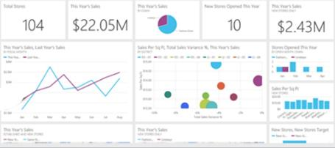
Keep a pulse on your business with live, interactive dashboards
Dashboards & Visualizations
Stream Analytics
Power BI
Event Hubs
Machine Learning
Storage
Power BI
SQL Database
HDInsight
Analytics for everyone, even non-data experts
Your whole business on one dashboard
Create stunning, interactive reports
Drive consistent analysis across your organization
Embed visuals in your applications
Get real-time alerts when things change
Notes:
Many of the services we’ve been talking about today are on the back-end. But your data and the results of analytics are only useful if they can be provided to those who need them – often people without deep data expertise.
That’s where Power BI comes in. Power BI is a cloud-based dashboard and visualization service that provides faster time to insight. It is used for visualizing, exploring and extracting insights from data. It brings together data from diverse sources to deliver rich, comprehensive views of your business. With Power BI, you can see all of your data in one place and share reports. Live dashboards and reports show visualizations and KPIs from data that reside both on-premises and in the cloud, providing a consolidated view across your business regardless of where your data lives.
T: Now that we’ve walked through everything, let’s take a look at the whole picture.

Slide 22

Transform data into intelligent action
Information Management
Big Data Stores
Machine Learning and Analytics
Intelligence
Data Sources
People
Data Factory
Data Lake Store
Machine Learning
Cognitive Services
Data Catalog
SQL Data
Warehouse
Data Lake Analytics
Bot Service
Apps
Web
Event Hubs
HDInsight
(Hadoop and Spark)
{ }
Cosmos DB
Cortana
Mobile
Apps
IoT Hubs
Stream Analytics
Dashboards & Visualizations
Bots
Sensors and devices
Azure Analysis Services
Azure Time Series Insight
Power BI
Automated Systems
Data
Intelligence
Action
Notes:
T: Cortana Intelligence provides everything you need to transform your organization’s data into intelligent action. Next, let’s take a look at another demo.

Slide 23
AI is new SQL
Trends and Advancements in space of Computer Vision and NLP

Slide 24
Data scientists now have increasing amounts of data to prepare, analyze and group — and from which to draw conclusions. Given the amount of data, exploring all possibilities becomes impossible. This means businesses can miss key insights from hypotheses the data scientists don’t have the capacity to explore.

Slide 25
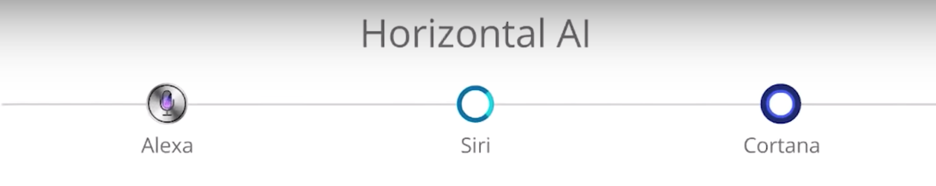
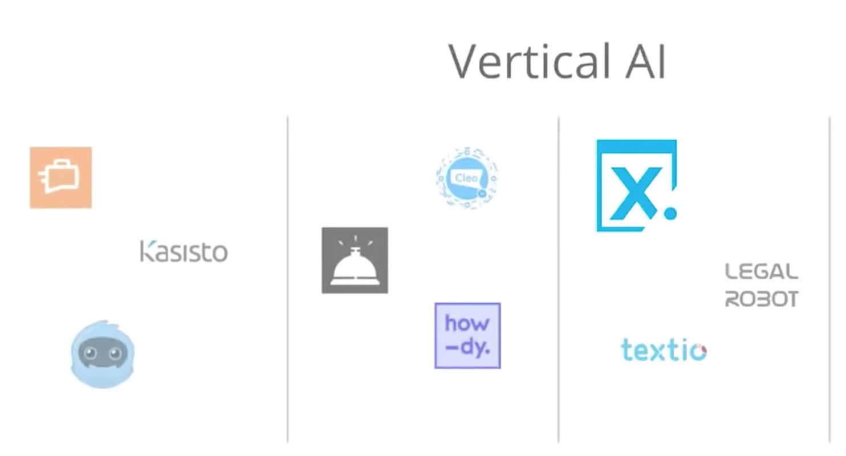

Slide 26
AI-driven development

Slide 27
AI Services
AI-driven development looks at tools, technologies and best practices for embedding AI into applications and using AI
AI infrastructure, AI frameworks ,AI platforms , AI Services
“Technology and thinking will shift to a point where the experience will connect people with hundreds of edge devices”

Slide 28
“By 2020, more than 40% of data science tasks will be automated”
What does it mean to us ?

Slide 29




Build applications that understand people
Intelligence
Vision
Speech
Language
Knowledge
Search
Cognitive Services
Computer Vision
Speaker Recognition
Text Analytics
Academic Knowledge
Bing Search API
Bot Framework
Face
Speech
Bing Speller
Entity Linking Service
Bing Image Search API
Cortana
Emotion
CRIS
Web Language Model
Knowledge Exploration Service
Bing Video Search API
Video
Linguistic Analysis
Recommendations
Bing News Search API
Language Understanding Intelligent Service
Bing Auto Suggest API
Faces, images, emotion recognition and video intelligence
Spoken language processing, speaker recognition, custom speech recognition
Natural language processing, sentiment and topics analysis, spelling errors
Complex tasks processing, knowledge exploration, intelligent recommendations
Bing engine capabilities for Web, Autosuggest, Image, Video and News
Notes:
What’s incredibly unique is the intelligence capabilities Cortana Intelligence offers, building on years of Microsoft research and innovation. These capabilities enable our customers to build intelligent systems and agents that can augment their organizational capabilities. For example, organizations can interact with customers and stakeholders in new ways and infer intent with vision, face, speech, text and sentiment analysis to customize responses and drive appropriate actions.
Microsoft Cognitive Services, a set of cloud services, APIs and SDKs that enable organizations to build intelligent systems that can see, hear, interpret and understand the world around you and makes all applications more intelligent, engaging and discoverable. Cognitive Services expands the existing perceptual intelligence capabilities like Vision, Speech, Text and Face detection to include new cognitive capabilities such as Emotion and customized Language Understanding. What we showcased with www.how-old.net is one example of what is possible.
Why choose these APIs? They work, and it’s easy.
Easy: The APIs are easy to implement because of the simple REST calls. Being REST APIs, there’s a common way to implement and you can get started with all of them for free simply by going to one place, one website, www.microsoft.com/cognitive. (You don’t have to hunt around to different places.)
Flexible: We’ve got a breadth of intelligence and knowledge APIs so developers will be able to find what intelligence feature they need; and importantly, they all work on whatever language, framework, or platform developers choose. So, devs can integrated into their apps—iOS, Android, Windows—using their own tools they know and love (such as python or node.js, etc.).
Tested: Tap into an ever-growing collection of powerful AI algorithms developed by experts. Developers can trust the quality and expertise build into each API by experts in their field from Microsoft’s Research organization, Bing, and Azure machine learning and these capabilities are used across many Microsoft first party products such as Cortana, Bing and Skype.
T: Next, Bot Frameworks.

Slide 30
Vision
From faces to feelings, allow your apps to understand images and video
Computer Vision API
Face API
Emotion API
Video API
Distill actionable information from images
Detect, identify, analyze, organize, and tag faces in photos
Personalize experiences with emotion recognition
Analyze, edit, and process videos within your app
Notes:
Vision
Computer Vision API: as a free trial on the website microsoft.com/cognitive. There are also SDKs and Samples available on GitHub or through NuGet, Maven, and Cocoapods for select platforms to make development easier. It’s important to note here that it’s not client side running code, but light wrappers around the REST calls to make integration easy.
A photo app would use this as a way to tag user photos and make it easier for users to search through their collections. An assistive app would use this as a way to describe the surroundings to visually-impaired users. Works really well on both indoor or outdoor images; it can recognize common household objects, and it can describe outdoor scenes. However, we did not train on aerial images (say from drones), or on many close ups (so pictures where we zoomed in extremely on the subject won't do well). We also do really well recognizing celebrities (as long as most of the face is visible, and they were facing the camera).
Face API: Some potential uses for this technology include facial login, photo tagging, and home monitoring. Or attribute detection to know age, gender, facial hair, etc.
Emotion API: is available in the Azure marketplace, as a free trial on the website microsoft.com/cognitive. See Computer Vision description.
Build an app that responds to moods. Using facial expressions, this cloud-based API can detect happiness, neutrality, sadness, contempt, anger, disgust, fear, and surprise. The AI understands these emotions based on universal facial expressions, and it functions cross-culturally, so your app will work around the world. Some use cases would be an advertising company wants to test user response to an ad, a tv studio wants to track responses to a pilot.
Video API: as a free trial on the website microsoft.com/cognitive. See Computer Vision description.
It brings Microsoft state of the art video processing algorithms to developers. With Video API, developers can analyze and automatically edit videos, including stabilize videos, create motion thumbnails, track faces, and detect motion. Use cases: For Stabilization: If you have multiple action videos, you can use the stabilization algorithm to make them less shaky and easier to watch. You can also use the stabilization algorithm as a first step in performing other video APIs. For Face Tracking: You can track faces in a video to do A/B testing in a retail setting. You can combine Video API Face Tracking with capabilities in Face API to search through surveillance, crime, or media footage to look for certain person. For Motion Detection: Instead of having to watch long clips of surveillance footage, the API will let you know what time motion occurred and its duration. For Video Thumbnail: Take a long video, such as a keynote presentation, and automatically create a short preview clip of the talk. For Face Tracking: Works best for frontal faces. Currently cannot detect small faces, side or partial faces. For Motion Detection: Detects motion on a stationary background (e.g. fixed camera). Current limitations of the algorithms include night vision videos, semi-transparent objects, and small objects. For Video Thumbnail: Take a long video, such as a keynote presentation, and automatically create a short preview clip of the talk.

Slide 31

Computer Vision APIs
Analyze an image Understand content within an image
OCR Detect and recognize words within an image
Generate thumbnail Scale and crop images, while retaining key content
Recognize Celebrities Thanks to domain specific models, ability to recognize 200K celebrities from business, politics, sports and entertainment around the World.
Notes:
Do you need an API that gives you actionable information about images used in your app? The Computer Vision API gives you the tools to understand the contents of any image. Create tags identifying objects, beings, or actions present in the image, and then craft coherent sentences to describe it. Whether you want to execute better image search, or you want to create an assistive app for the visually impaired, the Computer Vision API helps get the job done.

Slide 32
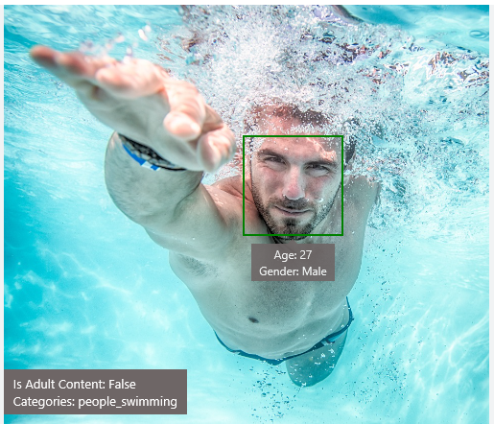
Analyze image
Type of image
Clip Art Type 0 Non-clipart
Line Drawing Type 0 Non-Line Drawing
Black & White Image False
Content of image
Categories [{ “name”: “people_swimming”, “score”: 0.099609375 }]
Adult Content False
Adult Score 0.18533889949321747
Faces [{ “age”: 27, “gender”: “Male”, “faceRectangle”: {“left”: 472, “top”: 258, “width”: 199, “height”: 199}}]
Image colors
Dominant Color Background White
Dominant Color Foreground Grey
Dominant Colors White
Accent Color

Slide 33

OCR
Good at
JSON:
{
"language": "en",
"orientation": "Up",
"regions": [
{
"boundingBox": "41,77,918,440",
"lines": [
{
"boundingBox": "41,77,723,89",
"words": [
{
"boundingBox": "41,102,225,64",
"text": "LIFE"
},
{
"boundingBox": "356,89,94,62",
"text": "IS"
},
{
"boundingBox": "539,77,225,64",
"text": "LIKE"
}
. . .
Scanned documents
Photos with text
Fine grained location information
LIFE IS LIKE
RIDING A BICYCLE
TO KEEP YOUR BALANCE
YOU MUST KEEP MOVING

Slide 34




Smart thumbnail
Smart cropping on
Smart cropping off

Slide 35

Recognize emotions Detect emotions based on facial expressions in photos and videos
Emotion APIs
Notes:
How are you feeling? Can your app tell? With the Emotion API, you can build an app that recognizes emotions according to facial expressions—giving you the capability to provide an amazing, personalized experience.
Using facial expressions, this cloud-based API can detect happiness, neutrality, sadness, contempt, anger, disgust, fear, and surprise. The AI understands these emotions based on universal facial expressions, and it functions cross-culturally, so your app will work around the world.

Slide 36
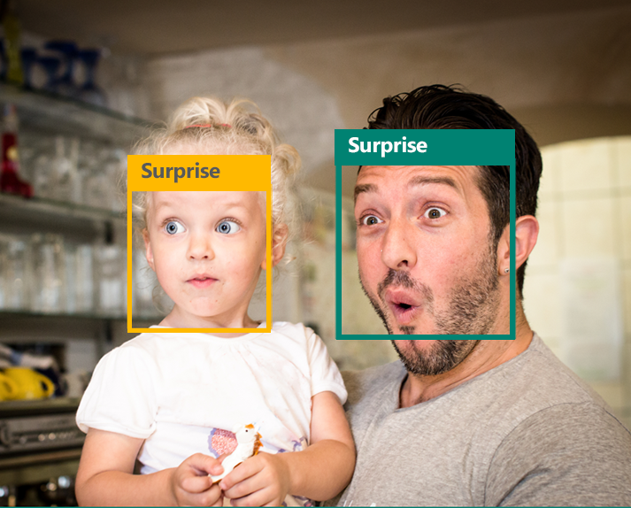
Emotion APIs
Face detection
"faceRectangle": {"width": 193, "height": 193, "left": 326, "top": 204} …
Emotion scores
“scores": { "anger": 5.182241e-8,
"contempt": 0.0000242813,
"disgust": 5.621025e-7,
"fear": 0.00115027453,
"happiness": 1.06114619e-8,
"neutral": 0.003540177,
"sadness": 9.30888746e-7,
"surprise": 0.9952837}

Slide 37

Face APIs
Face detection Detect faces and their attributes within an image
Face verification Check if two faces belong to the same person
Similar face searching Find similar faces within a set of images
Face grouping Organize many faces into groups
Face identification Search which person a face belongs to
Notes:
Detect human faces and compare similar ones, organize people into groups according to visual similarity, and identify previously tagged people in images.

Slide 38




Face APIs
Detection
"faceRectangle": {"width": 193, "height": 193, "left": 326, "top": 204}
…
Feature attributes
"attributes": { "age": 42, "gender": "male",
"headPose": { "roll": "8.2", "yaw": "-37.8", "pitch": "0.0" }}
Grouping
Identification
Jasper Williams

Slide 39

Video APIs
Stabilization Smooth and stabilize shaky video
Face detection and tracking Detect and track faces in videos
Motion detection Detect when motion occurs
Notes:
Intelligent video processing produces stable video output, detects motion, creates intelligent thumbnails, and detects and tracks faces.

Slide 40

Stabilization
The Stabilization API provides automatic video stabilization and smoothing for shaky videos
This API uses many of the same technologies found in Microsoft Hyperlapse
Best For: Small camera motions, with or without rolling shutter effects (e.g., holding a static camera, walking with a slow speed)

Slide 41
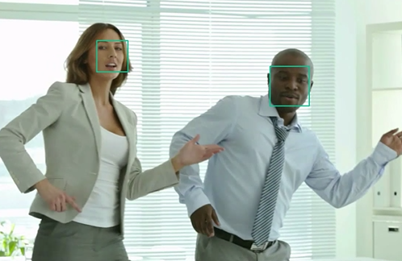
Face detection and tracking
High precision face location detection and tracking
Can detect up to 64 human faces in a video (no smaller than 24x24 pixels)
Detected and tracked faces are returned with coordinates and a Face ID to track throughout the video
Time (sec) | Face ID | x, y | Width, height
0 | 0 | 0.59, 0.23 | 0.09, 0.16
0 | 1 | 0.38, 0.15 | 0.07, 0.12
1 | 0 | 0.54, 0.25 | 0.09, 0.15
1 | 1 | 0.23, 0.18 | 0.07, 0.12

Slide 42
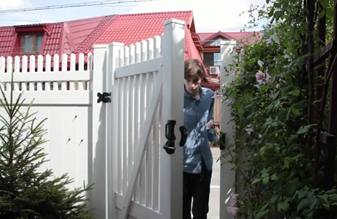
Motion detection
Indicates when motion occurs against a fixed background (e.g., surveillance video)
Trained to reduce false alarms, such as lighting and shadow changes
Current limitations:
No support for night-vision videos
Semi-transparent and small objects are not detected well
Start time | End time | In region
1.9 | 3.6 | 0
5.2 | 15.1 | 0

Slide 43
Speech
Hear and speak to your users by filtering noise, identifying speakers, and understanding intent
Bing Speech API
Speaker Recognition API
Custom Recognition Intelligent Service
Convert speech to text and back again, and understand its intent
Give your app the ability to know who's talking
Fine-tune speech recognition for anyone, anywhere
Notes:
Speech APIs provide state-of-the-art algorithms to process spoken language powered by Bing. This also includes speech synthesis for a subset of languages supported by speech recognition. With these APIs developers can easily include the ability to add speech driven actions into their applications. In certain cases, the APIs allow for real-time interaction with the user as well. Additional capabilities include voice recognition and speaker identification as well as providing partial transcription, meaning that for supported languages the developer can get partial results before the user has finished speaking. The initial release supports 7 languages.
Bing Speech API: At the time of publication, this data was not available. Please email Rebecca Duffy, reduffy@microsoft.com, if you would like more information.
We also have SDKs available for Speech.
CRIS: The Custom Recognition Intelligent Service (CRIS) enables you to create customized language models and acoustic models tailored to your application and your users. By uploading speech and/or text data to CRIS that reflects your application and your users, you can create custom models that can be used in conjunction with Microsoft’s existing state-of-the-art speech models. To customize the acoustic model to a particular domain, a collection of speech data is required. This collection consists of a set of audio files of speech data, and a text file of transcriptions of each audio file. The audio data should be representative of the scenario in which you would like to use the recognizer. If you were building an app to search MSDN by voice, it’s likely that terms like “object-oriented” or “namespace” or “dot net” will appear more frequently than in typical voice applications. Customizing the language model will enable the system to learn this. CRIS uses acoustic or language model adaptation to enable the speech recognizer to learn the characteristics of the customer’s data while still getting the benefits of all the data and expertise that went into creating the base models that power the Speech API.
For acoustic model adaptation, the technology is described in this paper: http://research.microsoft.com/pubs/194346/0007893.pdf
Works well when the data is uploaded to CRIS is truly representative of the user population and the expected usage of the application. For language model adaptation, it works best when the data uploaded reflects what people would actually say. Uploading simply a list of new terms is better than nothing but will not be as effective. For acoustic model adaptation, if you want to adapt to elderly speech, you need to upload the speech from many different elderly users, not just one or two. If you upload just one person’s voice, CRIS will learn to do a great job on that voice but will not necessarily learn to generalize to other elderly voices. Similarly, if you want to adapt to a new environment, like a factory, you should upload speech data from many speakers in the factory, not just one.
Speaker Recognition API: Microsoft's state-of-the-art cloud-based speaker recognition algorithms to recognize a human's voice in audio streams. It comprises two components: speaker verification and speaker identification. Speaker Verification can automatically verify and authenticate users from their voice or speech. It is tightly related to authentication scenarios and is often associated with a pass phrase. Hence, we opt for text-dependent approach, which means speakers need to choose a specific pass phrase to use during both enrollment and verification phases. Speaker Identification can automatically identify the person speaking in an audio file given a group of prospective speakers. The input audio is paired against the provided group of speakers, and in case there is a match found, the speaker’s identity is returned. It is text-independent, which means that there are no restrictions on what the speaker says during the enrollment and recognition phases. A use case is biometric authentication using voice.
https://blogs.technet.microsoft.com/machinelearning/2015/12/14/now-available-speaker-video-apis-from-microsoft-project-oxford/
We also have SDKs available for Speaker Reco

Slide 44

Speech APIs
Voice recognition (speech to text) Converts spoken audio to text
Voice output (text to speech) Synthesize audio from text
Speech intent recognition Convert spoken audio to intent
Notes:
Convert audio to text, understand intent, and convert text back to speech for natural responsiveness.
Speech Intent Recognition can, in addition to returning recognized text from audio inputs, also return structured information about the speech to apps that parse the intent of the speaker and drive further actions by the app. Models trained by LUIS service are used to generate the intent.

Slide 45
Voice recognition
Short form
Long form
Duration of Audio | < 15 seconds | < 2 minutes
Final Result | n-best choice | Best choice, delivered at sentence pauses
Partial Results | Yes | Yes
450 6th St. San Francisco
********* Final N-BEST Results *********
[0] Confidence=Normal Text="450 six St San Francisco."
[1] Confidence=Normal Text="For 50 six St San Francisco."
[2] Confidence=Normal Text="456th St San Francisco."
[3] Confidence=Normal Text="450 six St in San Francisco."
[4] Confidence=Normal Text="456 St San Francisco."

Slide 46
Voice output
Synthesize audio from text via POST request
Maximum audio return of 15 seconds
17 languages supported
<speak version="1.0" xmlns="http://www.w3.org/2001/10/synthesis" xmlns:mstts="http://www.w3.org/2001/mstts" xml:lang="en-US">
<voice name="Microsoft Server Speech Text to Speech Voice (en-US, ZiraRUS)">
Synthesize audio from text, to speak to your users.
</voice></speak>
Synthesize audio from text, to speak to your users

Slide 47
Custom Recognition
Customize both language and acoustic models Tailor speech recognition to your app and environment
Notes:
Eliminate speech recognition barriers like speaking style, background noise, and vocabulary.
Does your speech recognition work with varied user populations, vocabularies, or with background noise? The Custom Recognition Intelligent Service (CRIS) helps you create custom speech recognition endpoints—so accents and environments are features, not challenges.
Customize your speech recognition by vocabulary and speaking style, create custom acoustic models to match the expected environment of your users, and tap into the API's powerful intelligence to create speech recognition endpoints customized to your app's needs. Turn language barriers into features with CRIS.

Slide 48
Custom Recognition Intelligent Service
Create custom language models for the vocabulary of the application
Adapt acoustic models to better match the expected environment of the application’s users
Deploy to a custom endpoint and access from any device
Record
audio
Adapt
Deploy
Transcribe

Slide 49
Speaker recognition API
“”
Speaker verification Check if two voices are the same
Speaker identification Identify who is speaking
Notes:
Your users' voices are their passports with the Speaker Recognition API. Your app can authenticate identities by using someone's voice, giving your users the capability to interact securely through speech.

Slide 50
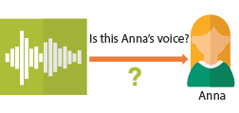
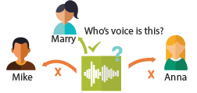
Speaker recognition APIs
“”
Enrollment
Create a unique voiceprint for a profile
Is this Anna’s voice?
Recognition
After enrolling one or more voices, identify who is speaking from an audio clip
Anna
Verification
Who’s voice is this?
Confirm if a voice belongs to a previously enrolled profile
Marry
Mike
Anna

Slide 51




Speech
Language
Process text and learn how to recognize what users want
Bing Spell Check API
Web Language Model API
Linguistic Analysis API
Language Understanding Intelligent Service
Text Analytics API
Detect and correct spelling mistakes within your app
Leverage the power of language models trained on web-scale data
Easily parse complex text with language analysis
Teach your apps to understand commands from your users
Detect sentiment, key phrases, topics, and language from your text
Notes:
Bing Spell Check API: Microsoft’s state-of-the-art cloud-based spelling algorithms to detect a wide variety of spelling errors and provide accurate suggestions. Using Bing Spell Check, your mobile and PC apps will be powered with state-of-the-art spelling capabilities. Our service is trained on a massive corpus of data gleaned from billions of web pages. There is no need to train your own models. The speller model is updated regularly and incorporates new terms and brands almost as quickly as they appear on the web. This API is available through Microsoft Cognitive Services for customers with low-volume and high-latency jobs. For high-volume and low-latency we have an internal API which may be more suitable. Contact donaldbr directly for more information.
Use cases: 1) Improve the quality of a website's product search 2) provide spell correction for a keyboard app 3) provide spell correction for text fields in an app or web page 4) detect errors in UI text and user data. See https://blogs.msdn.microsoft.com/msr_er/2010/12/15/building-a-better-speller-bing-and-microsoft-research-offer-prizes-for-best-search-engine-spelling-alteration-services/ The speller is exceptional at common spelling errors with low edit-distance (such as febuary->February) but a lot of other spellers are good at that as well. We Do a very good job with word breaking, proper names in context (try "director stephen spielberg") and fictional character names, just a few examples. Areas that are a challenge are capitalization (we don't know what to do with "March" for example, even with context) and consistency (there are times when we will flag a word only intermittently based on the context).
Web Language Model API: Web Language API indexes the web and Bing queries to allow users to calculate the probabilities of natural language expressions and estimate a list of most likely words to follow an existing sequence of words. Use this API to insert spaces into a string of words without spaces, like a hashtag or URL. Use this API to rerank machine translation/speech recognition candidate sentences based on probability of the sentence.
Use this API for academic research. http://research.microsoft.com/apps/pubs/default.aspx?id=130762
We also have SDKs available for WebLM
Linguistic Analysis API: The Linguistic Analysis API helps you gain insights from text. Given a natural language parse, it’s easy to identify the concepts and entities (noun phrases), actions (verbs and verb phrases), descriptive words, and more. The processed text can provide useful features for classification tasks such as sentiment analysis.
We also have SDKs available for Linguistic Analysis.
LUIS: Language Understanding Intelligent Service (LUIS) allows developers to build a model that understands natural language and commands tailored to their application. Example: You can say “turn down the thermostat in the living room,” send it to a LUIS model, and instead of just returning the text that represents what was said, LUIS will return: the action is “turn down,” the location is “living room,” and the target is “thermostat.” LUIS allows developers to iteratively build on these models and take speech or text input and return a structured representation of what the person said. Not only that but by build LUIS will help developers create and train smart conversational bot (Intercom or Slack) with a single button. LUIS will also offer action fulfillment capabilities by simple integration with webhooks. LUIS works pretty well it comes to intents. For the entities, the learning curve is slower especially when the number of entities increases. LUIS only supports 20 intents & 10 entities yet by build each entities can have up to 10 children.
Text Analytics API: At the time of publication, this data was not available. Please email Rebecca Duffy, reduffy@microsoft.com, if you would like more information.

Slide 52



Dashboards & Visualizations
Information Management
Big Data Stores
Machine Learning and Analytics
Intelligence
Data Sources
Data Factory
Data Lake Store
Machine Learning
Cognitive Services
Data Catalog
SQL Data
Warehouse
Data Lake Analytics
Bot Framework
Apps
HDInsight
(Hadoop and Spark)
Event Hubs
Cortana
Sensors and devices
Stream Analytics
Dashboards & Visualizations
Power BI
Data
Data
Intelligence
Notes:
Many of the services we’ve been talking about today are on the back-end. But your data and the results of analytics are only useful if they can be provided to those who need them – often people without deep data expertise.
That’s where Power BI comes in. Power BI is a cloud-based dashboard and visualization service that provides faster time to insight. It is used for visualizing, exploring and extracting insights from data. It brings together data from diverse sources to deliver rich, comprehensive views of your business. With Power BI, you can see all of your data in one place and share reports. Live dashboards and reports show visualizations and KPIs from data that reside both on-premises and in the cloud, providing a consolidated view across your business regardless of where your data lives.
T: Now that we’ve walked through everything, let’s take a look at the whole picture.

Slide 53
AI Maturity

Slide 54
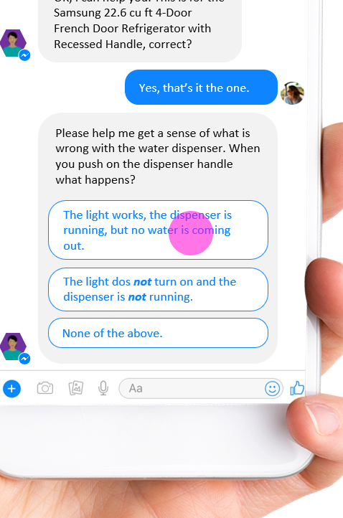

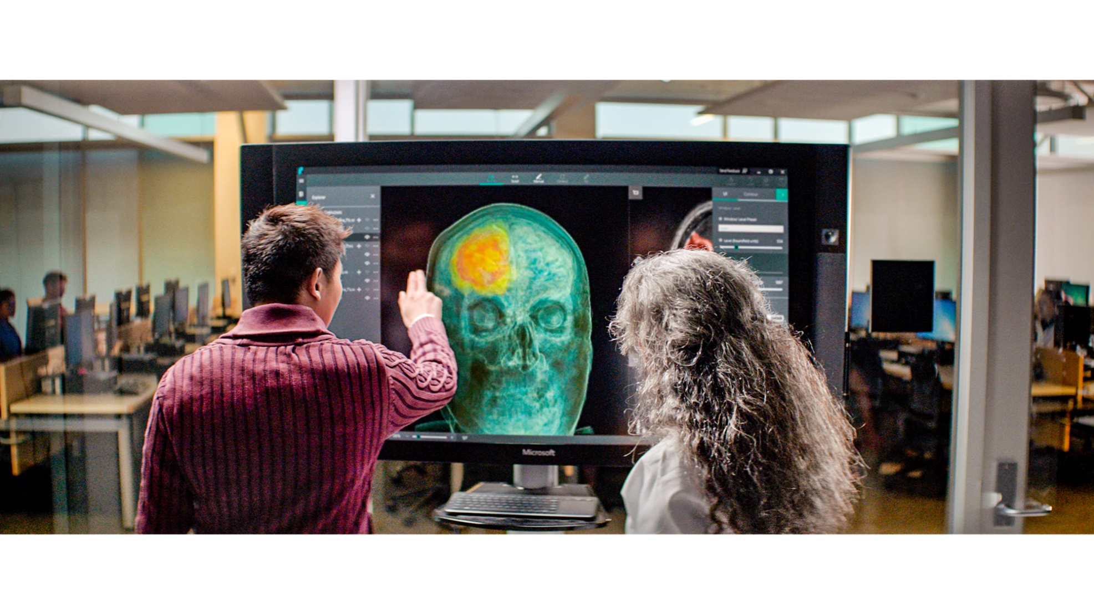


ML/AI is core component of many applications
New generation of business agents
B2B, B2C, B2E
Person, object, and activity detection
Retail, manufacturing, security
AI assisted professionals
Marketing, legal, financial
Knowledge mining
Documents, video
Autonomous systems
Vehicles, networks, RPA

Slide 55
Azure ML Services
Solutions for every possible requirement

Slide 56





Slide 57


























Advanced analytics pattern in Azure
Data collection and understanding, modeling, and deployment
Model training
Serving storage
Sensors and IoT (unstructured)
Azure ML service
Azure ML Studio
ML server
Azure Databricks (Spark ML)
SQL Server (in-database ML)
Data Science VM
Batch AI
Applications
Cosmos DB
Long-term storage
Data processing
Logs, files, and media (unstructured)
SQL DB
Azure Data Lake store
Azure Storage
Cosmos DB
SQL DB
Azure Data Lake Analytics
Azure Databricks
HDInsight
Orchestration
Trained model hosting
SQL DW
Business/custom apps (structured)
Power BI Dashboards
Azure Container Service
SQL Server (in-database ML)
Azure Analysis Services
Azure Data Factory
© Microsoft Corporation

Slide 58
More People Building Machine Learning Models
ML Expert
AML SDK /
Notebooks
No Code
Code First
Auto ML (UX+SDK)
Power BI
No ML

Slide 59

Challenges
Setup development environment
Not familiar with syntax
Manage hardware & infrastructure
Manage scale (training and inference)
Lack of flexibility
Integration with production environment

Slide 60

More People Building Machine Learning Models
ML Expert
AML SDK /
Notebooks
Azure Machine Learning service Visual Interface
No Code
Code First
Auto ML (UX+SDK)
Power BI
No ML

Slide 61
Azure Machine Learning Studio

Slide 62





Azure machine learning studio
A fully-managed cloud service that enables you to easily build, deploy and share predictive analytics solutions
Use Azure Machine Learning to deploy your model into production as a web service in minutes
Work with familiar coding languages such as R and Python while benefitting from hundreds of built-in packages and support for custom code
Deploy models to production as web services that can be called from any device, anywhere, using any data source
Easily share your solution with the world on the Azure Marketplace
© Microsoft Corporation

Slide 63
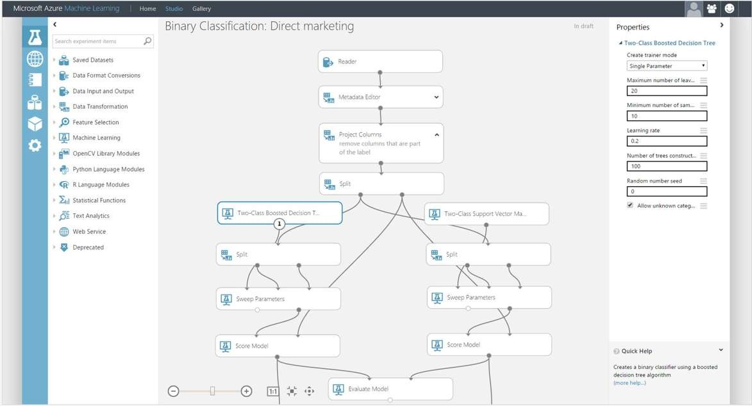
AZURE MACHINE LEARNING STUDIO
Platform for emerging data scientists to graphically build and deploy experiments
Rapid experiment composition
> 100 easily configured modules
for data prep, training, evaluation
Extensibility through R & Python
Serverless training and deployment
Some numbers:
100’s of thousands of deployed models serving billions of requests

Slide 64
What is Machine Learning?

Slide 65
What is Machine Learning?
Machine learning is the subfield of computer science that gives computers the ability to learn without being explicitly programmed.
- Arthur Samuel, 1959
Learns from past behaviour and make predictions or decisions
Extraction of knowledge from data
Notes:
Utilize the simple ASA rule based interface within the Azure Management Portal to create, manage and control rules.
Jobs in ASA have 3 parts like we talked about earlier:
Input which is the telemetry data stream, an output which is where you want the results of the job to go to and a query which is defined to run over your input to determine your output.
Each job can be thought of as a materialized view
User defines an output dataset as a function of a number of input datasets
User requests that ASA compute and keep the output dataset up-to-date in the output location at all times With as low an observation latency as possible
ASA service maintains a database of job definitions
When a job is started, it is scheduled for execution on a YARN cluster in the appropriate data center
All elements of a job definition can be defined and edited via REST endpoints.
In addition Data Model supports Two types of objects: Events and Data.
Events correspond to things that occur
Each event has a timestamp
Timestamp is defined as a property of the event (as opposed to an ambient value observed when the event being processed)
Data corresponds to values that changes over time that is contained in the event.
Offering both notions (Events & Data) enables user-friendly query experiences such as :
“Count how many errors occurred, per machine, in every 3-minute window” or
“Tell me if an error was reported while the reporting machine was down”.
No support for user-visible start-time, end-time, edges, retractions, etc.
ASA understands these notions under the covers though
Types: Long, Double, String (default collation only), and Date
To summarize Azure Stream Analytics is a a key service in implementing hot path analytics for IoT

Slide 66





Machine Learning
Machine learning is the subfield of computer science that gives “computers the ability to learn without being explicitly programmed“.

Slide 67
Creating Azure ML Account
Notes:
For a recorded presentation by Azure IoT Program Management through C+E University: IoT Online webinar series: please visit:
https://mspartnerlp.partner.microsoft.com/LearningPath/LearningPath/DLPaths?trackId=2918&rowId=3606&trackPathId=14612

Slide 68
Workflow of Azure ML project/experiment
Notes:
For a recorded presentation by Azure IoT Program Management through C+E University: IoT Online webinar series: please visit:
https://mspartnerlp.partner.microsoft.com/LearningPath/LearningPath/DLPaths?trackId=2918&rowId=3606&trackPathId=14612

Slide 69
Workflow of Azure ML
GET THE DATA
PREPARE THE DATA
FEATURE SELECTION
CHOOSE AND APPLY LEARNING ALGORITHMS
TRAIN AND EVALUATE THE MODEL

Slide 70
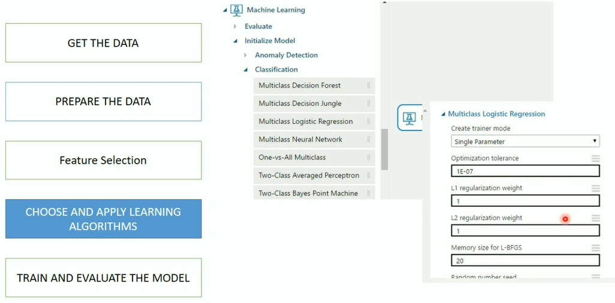
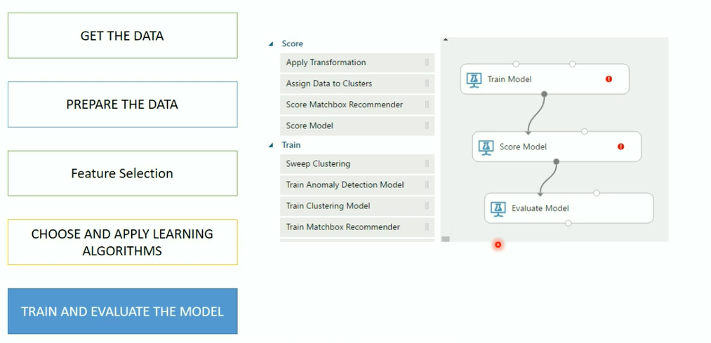
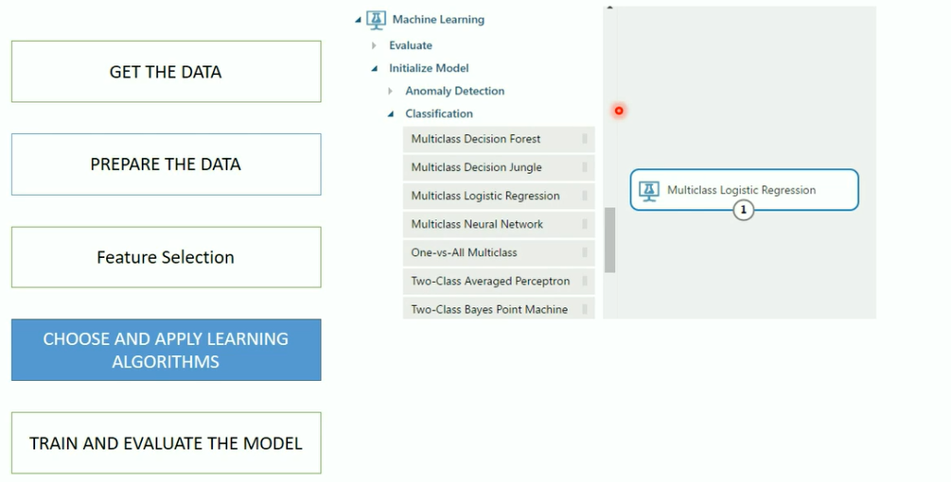
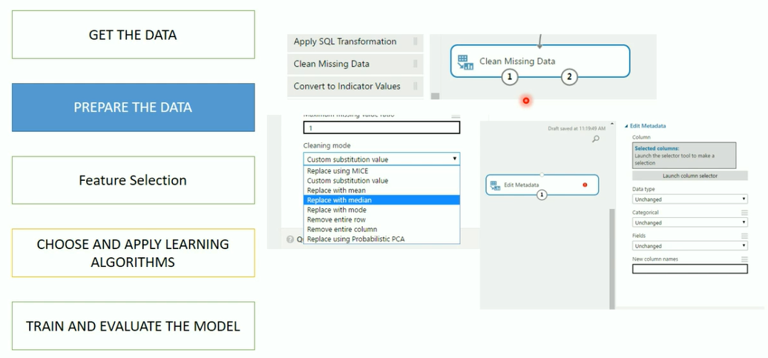
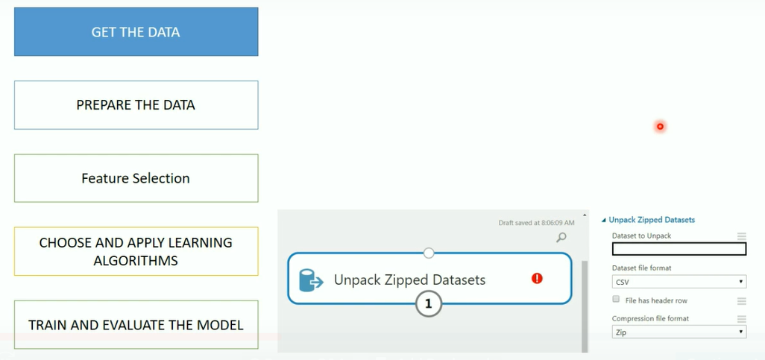
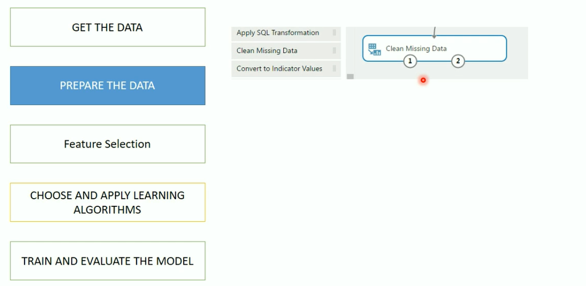
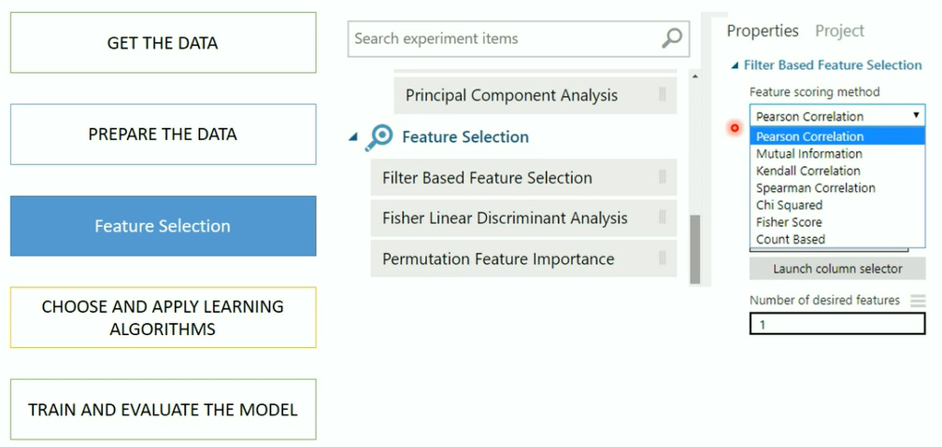
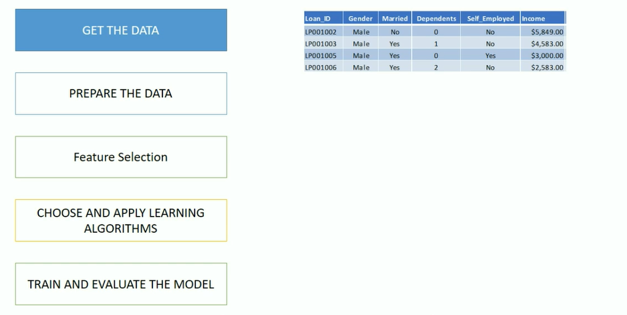
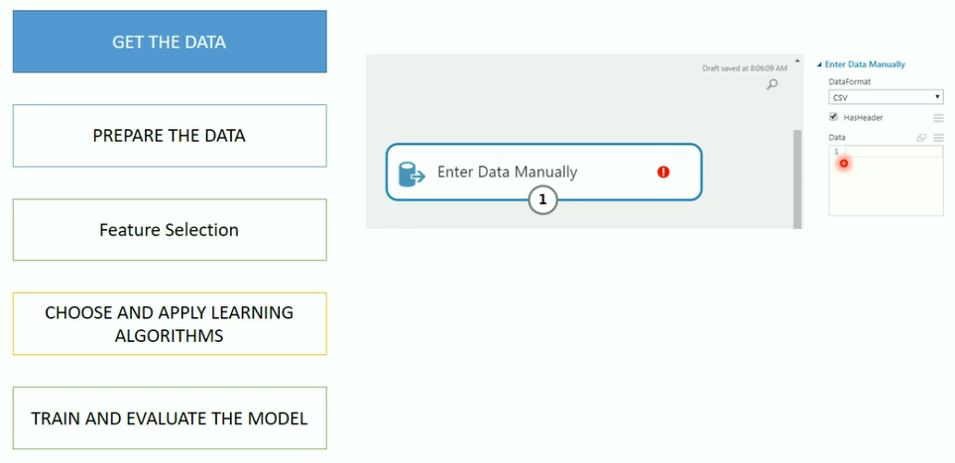
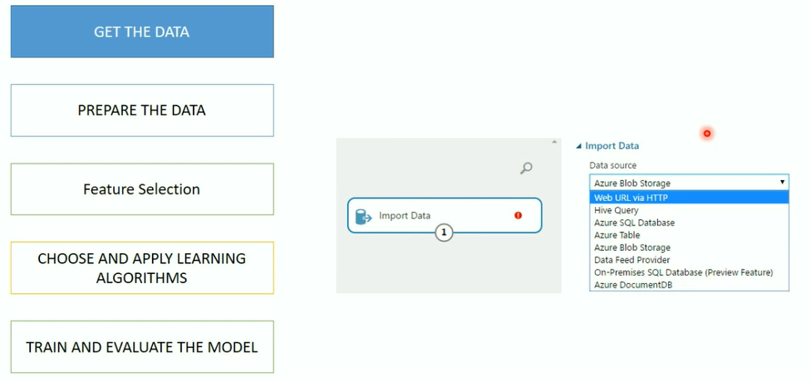
Workflow of Azure ML

Slide 71
Azure ML Algorithm CheatSheet
Notes:
For a recorded presentation by Azure IoT Program Management through C+E University: IoT Online webinar series: please visit:
https://mspartnerlp.partner.microsoft.com/LearningPath/LearningPath/DLPaths?trackId=2918&rowId=3606&trackPathId=14612

Slide 72
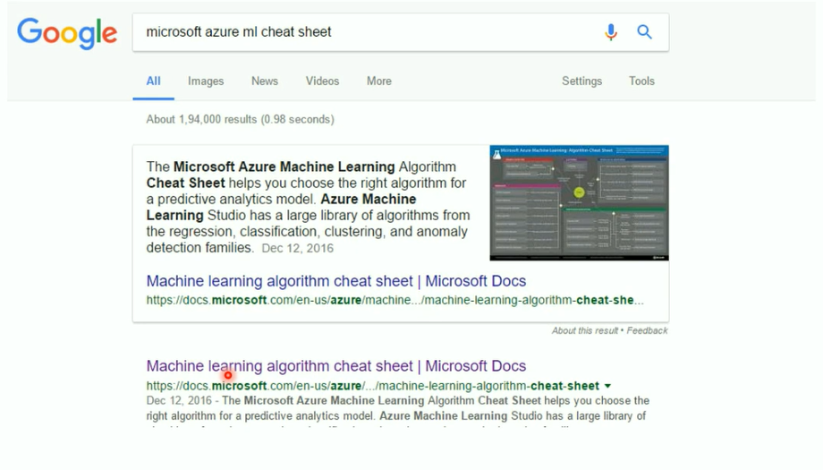

Slide 73
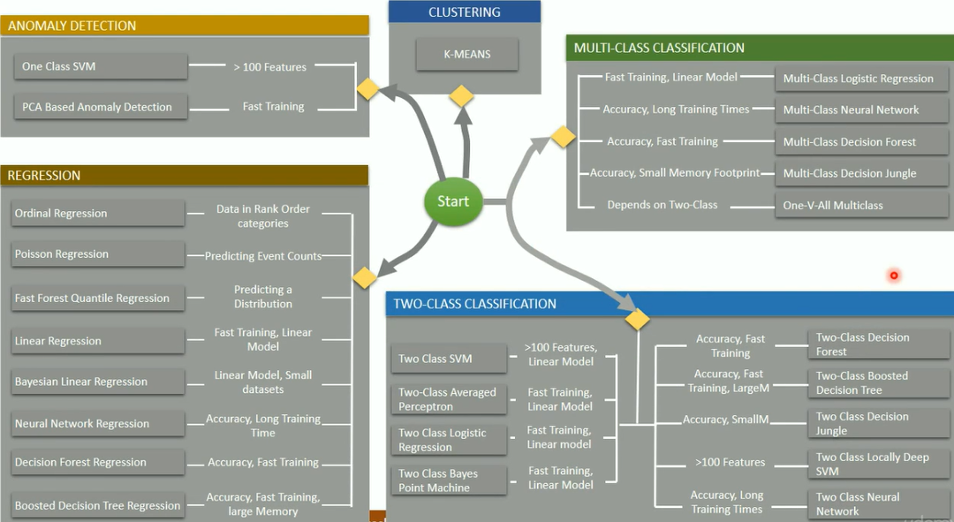

Slide 74
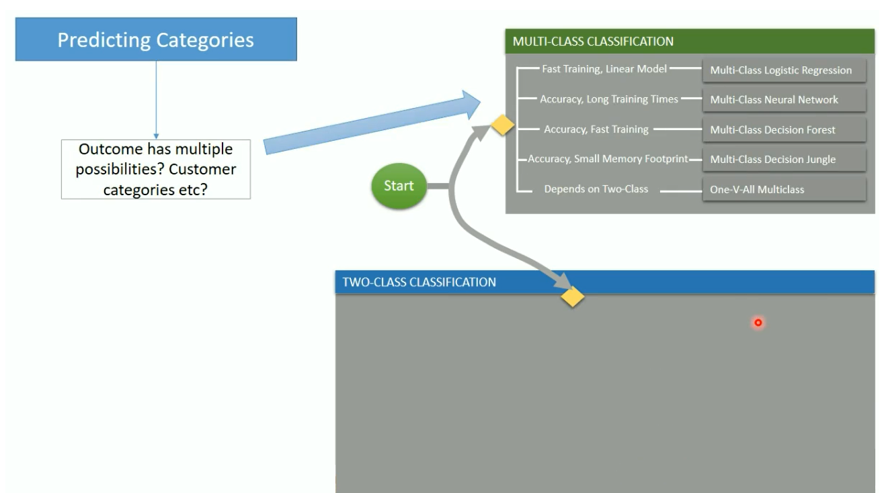
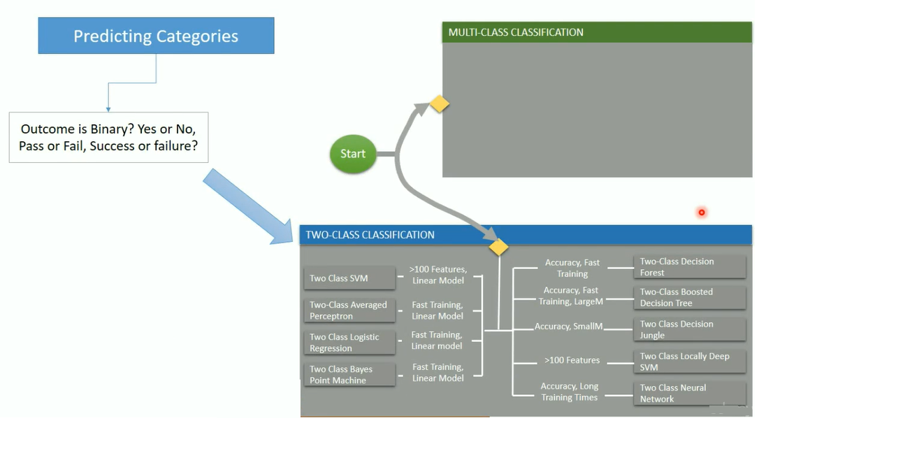

Slide 75
Hands on

Slide 76
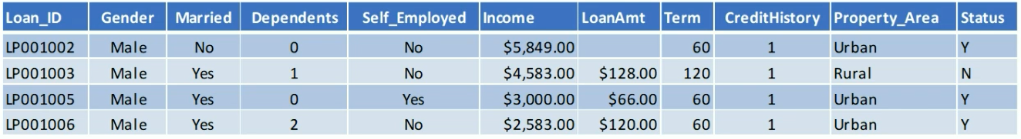
Problem Statement
Automate loan eligibility process
Identify customers whose loan will be approved

Slide 77
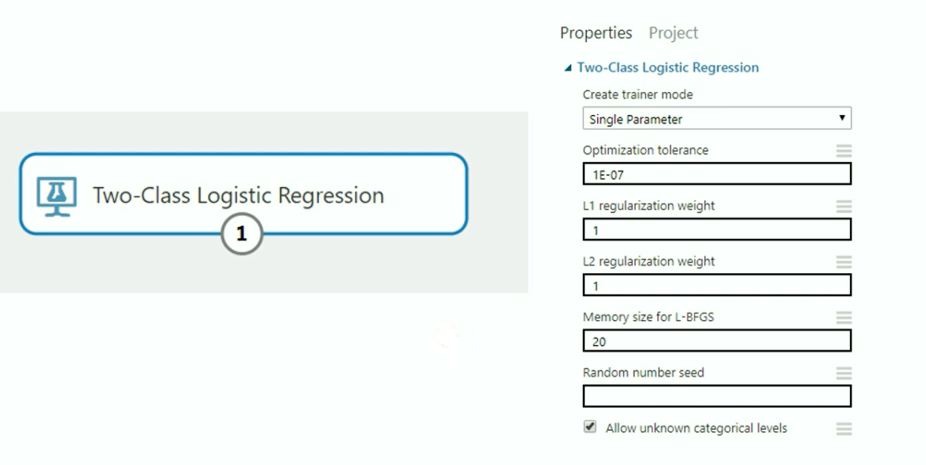
Logistic Regression in Azure ML

Slide 78

What are Hyperparameters?

Slide 79
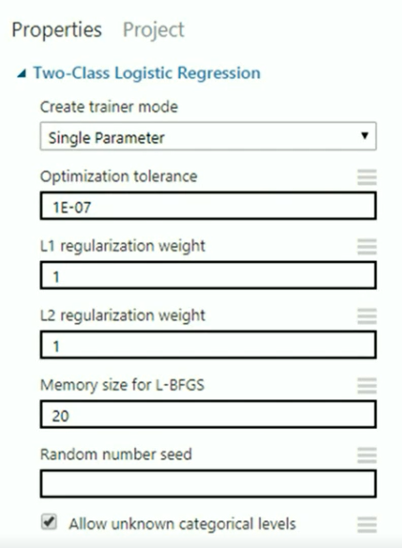
Parameters to Logistic Regression
Create Trainer Mode
• Single Parameter - Provide specific set of values
• Parameter Range - specify multiple values and get the optimum set for given configuration
Optimization Tolerance - Threshold Value to stop the model iterations on trained dataset
Memory Size for L-BFGS - Amount of memory to use for next steps and direction
Random Number Seed - Random integer number that is used for reproducing the same results
Allow Unknown Categorical Levels - Creates an additional "Unknown" level

Slide 80
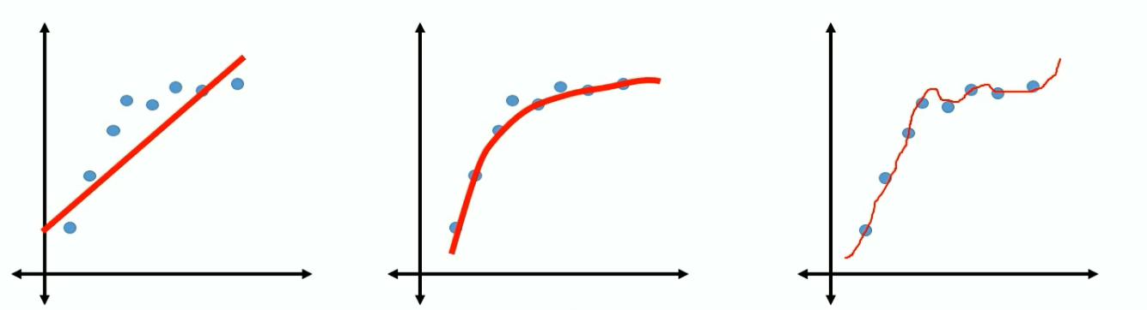
Regularization Weight
b0 + b1X b0 + b1X1 ² b0 + b1X1 ² + b2X2³
Under-fit Right Over Fit
What if the effect of such weights is reduced significantly
Or reduced to zero

Slide 81
Regularization Weight
L2 (Ridge) shrinks all the coefficient by the same proportions but eliminates none
L1(Lasso) can shrink some coefficients to zero, performing variable selection.
Both L1 and L2 regularization prevents overfitting by shrinking (imposing a penalty) on the coefficients.
L2 penalizes one big weight more than many small weights.
With L2, you tend to end up with many small weights, while with L1, you tend to end up with larger weights, but more zeros.

Slide 82
Hands on – Hyper Tuning

Slide 83
What is a Decision Tree?

Slide 84
What is Decision Tree?
Supervised learning method
Decision support tool that uses a tree-like graph or model of decisions and their possible consequences
Various variations such as Boosted Decision Tree, Decision Forest, Decision Jungle
Can be used for categorical as well as continuous variables

Slide 85
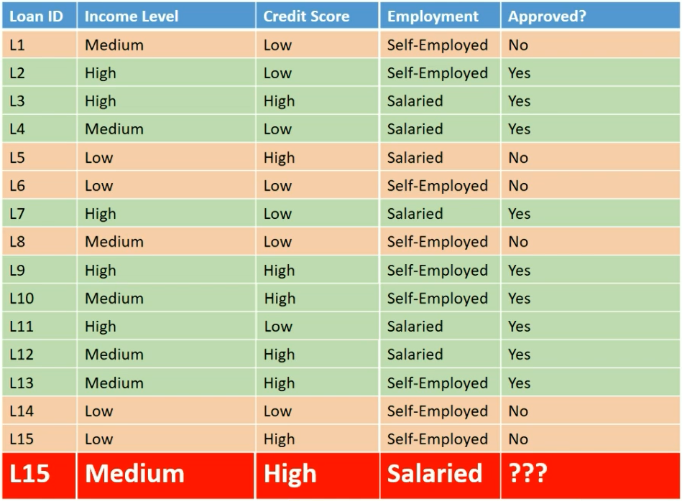

Slide 86
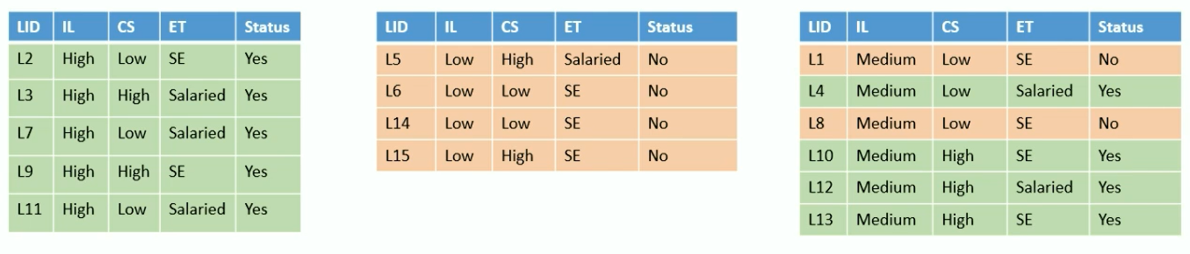
Income
Level
HIGH
LOW
Medium
Pure Subset Pure Subset Split Further

Slide 87
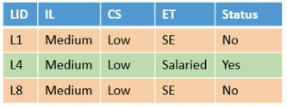
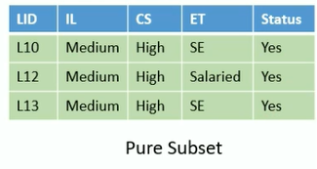
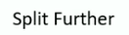
Income
Level
HIGH
LOW
Medium
Credit Score
LOW
HIGH

Slide 88
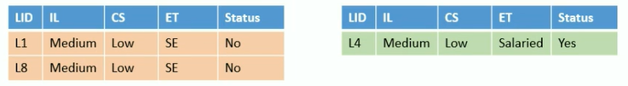
Income
Level
HIGH
LOW
Medium
Credit Score
LOW
HIGH
Employment Type
SE
Salaried
Pure Subset Pure Subset

Slide 89
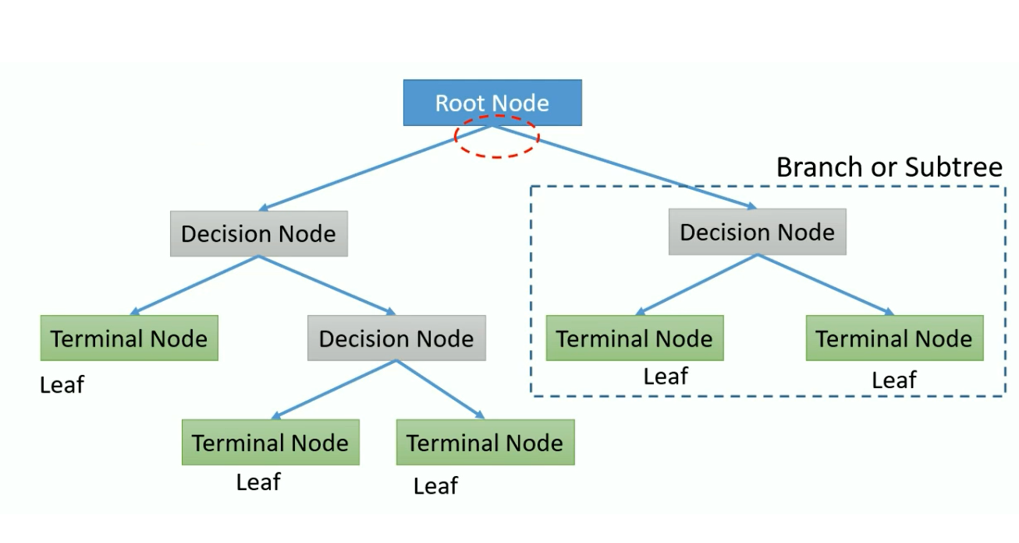
Decision Tree Terms

Slide 90
Ensemble learning

Slide 91

Everyday Ensemble Learning

Slide 92
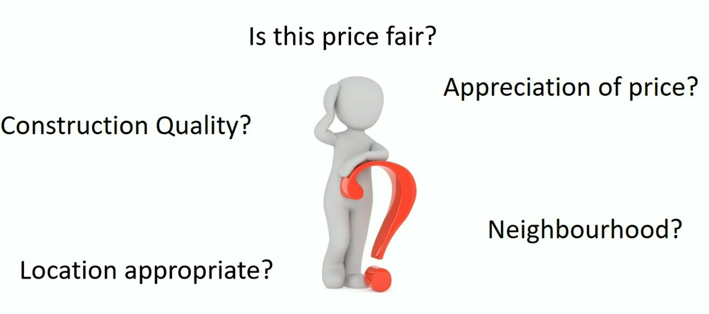
Decision?

Slide 93

Decision?
Broker or real estate portal to check
fair price, price appreciation
Friend or colleague who stays nearby
or stayed in the neighbourhood
Inspection by an architect for quality
checks and structural defects.

Slide 94



Decision?
Is this price fair?
Appreciation of price?
Construction Quality?
Location appropriate?
Neighbourhood?

Slide 95
Ensemble Learning
All algorithms have errors
Collective wisdom is higher than the individual intelligence
Generate a group of base learners and combined result gives higher accuracy
Different base learners can use different,
Parameters
• Sequence
Training sets etc
Two major Ensemble Learning Methods
• Bagging
• Boosting

Slide 96


Bagging
Various models are built in parallel
All models vote to give the final prediction

Slide 97
Boosting
Train the Decision Tree in a sequence
Learn from the previous tree by focussing on incorrect observations
Build new model with higher weight for incorrect
observations from previous sequence

Slide 98
Hands on – Decision Trees

Slide 99

https://gallery.azure.ai/

Slide 100
Data Science Virtual Machines (DSVM)

Slide 101


Data Science Virtual Machines

Slide 102



Slide 103


Slide 104




Why Data Science VMs?
Elastic analytics desktop in the cloud
Get started quickly on Azure Machine Learning
Pre-setup environment at work and school
Enterprise Ready and globally available

Slide 105



Productive Services Empower data science and development teams
Integrated data science & data engineering teams
Desktop solutions not adequate
Need a unified big data & machine learning solution
Individual data scientists
Desktop solutions adequate
Need cloud for sporadic compute needs
+
Azure Databricks
Azure Machine Learning service
Machine Learning VMs
Notes:
We realize that companies are at different stages of building data science teams.
From a sales perspective, we would like you to focus on companies that are building end to end big data and machine learning solutions as this where you will drive maximum amount of Azure consumption.
For these customers, we recommend starting with Azure Databricks and enhancing the ML experience with Azure Machine Learning.
Now we also realize that a good number of projects that are not done on big data or by big integrated teams.
For these customers, we have a set of Machine Learning VMs that are pre-provisioned with popular open source tools and packages. These are essentially desktops in the cloud that enable data scientists to quickly get up and running for their projects.
Let’s look at how we use Azure Databricks and Azure ML together.

Slide 106
Azure Machine Learning service

Slide 107
WHAT IS AZURE MACHINE LEARNING SERVICE?
Set of Azure Cloud
Services
Python SDK
That enables you to:
Prepare Data
Build Models
Train Models
Manage Models
Track Experiments
Deploy Models

Slide 108










Custom AI
Typical E2E Process
Prepare
Experiment
Operationalize/Deploy
…
Data Science Virtual Machine Azure Databricks
Machine Learning Compute
Azure Container Instances Azure Kubernetes Service
Azure Data Factory
Azure Databricks
Azure ML service
Orchestrate

Slide 109

Azure ML Concept
Model Management
Model Management in Azure ML usually involves these four steps
Step 1:
Step 2:
Step 3:
Step 4:

Slide 110
Azure ML Artifact
Compute Target
Currently supported compute targets
Compute Target | Training | Deployment
Local Computer | ✓
A Linux VM in Azure (such as the Data Science Virtual Machine) | ✓
Azure ML Compute | ✓
Azure Databricks | ✓
Azure Data Lake Analytics | ✓
Apache Spark for HDInsight | ✓
Azure Container Instance |  | ✓
Azure Kubernetes Service |  | ✓
Azure IoT Edge |  | ✓
Field-programmable gate array (FPGA) |  | ✓

Slide 111





Azure ML Artifact
Deployment
Deployment is an instantiation of an image. Two options:
Web service
IoT Module

Slide 112



Why Intelligent Edge?
High-speed data processing, analytics and shorter response times are more essential than ever.
Intelligent Cloud
Business agility and scalability: unlimited computing power available on demand.
Intelligent Edge
Can handle priority-one tasks locally
even without cloud connection.
Can handle generated data that is too large to pull rapidly from the cloud.
Enables real-time processing through intelligence in or near to local devices.
Flexibility to accommodate data privacy related
requirements.

Slide 113

Services
Customer journey
Data Prep
Build and Train
Manage and Deploy
Python ML developer
Azure ML service
(OSS frameworks, Hyperdrive, Pipelines, Automated ML, Model Registry)
Azure ML service
(containerize, deploy, inference and monitor)
Azure ML service
(Pandas, NumPy etc. on AML Compute)
+
Apache Spark / Big Data
Azure Databricks
(Apache Spark Dataframes, Datasets, Delta, etc.)
Azure Databricks + Azure ML service
(Spark MLib and OSS frameworks +
Automated ML, Model Registry)
Azure ML service
(containerize, deploy, inference and monitor)

Slide 114
Comparable Table
 | Azure Machine Learning Studio | Azure Machine Learning Services
Pros | Rapid development (Drag and Drop) Works well with relatively simple datasets Pre-built ML algorithms Cheap | Fast (VMs with GPUs) Different optimization methods, CI/CD pipeline Full control during training Manage computing resources (choose VM size) Use open source ML libraries
Cons | Can be slow Limited optimization methods, operationalized architecture Less control during training Fixed computing resources | More elaborate to build, require deeper knowledge of machine learning Deeper models need much more data with much more memory Higher costs for VM with GPU

Slide 115
Demo –Deployment

Slide 116
Demo – Hyper Tuning Parameters

Slide 117
Azure Databricks
Databricks Spark as a managed service on Azure

Slide 118



Azure Databricks key audiences & benefits
Data scientist
Data engineer
CDO, VP of analytics
Integrated workspace
Easy data exploration Collaborative experience Interactive dashboards Faster insights
Best Spark & serverless
Databricks managed Spark
Improved ETL performance
Zero management clusters, serverless
Easy to schedule jobs Automated workflows
Enhanced monitoring & troubleshooting
Automated alerts & easy access to logs
Zero Management Spark
Cluster democratization (serverless)
Fast, collaborative analytics platform accelerating time to market
No dev-ops required
Enterprise grade security
Encryption
End-to-end auditing
Role-based control
Compliance
Unified analytics platform
Provided by Microsoft and Databricks under NDA

Slide 119









A R T I F A C T S
A Z U R E
D A T A B R I C K S
C O R E
Azure Databricks

Slide 120

M M L S P A R K
Microsoft Machine Learning Library for Apache Spark (MMLSpark) lets you easily create scalable machine learning models for large datasets.
It includes integration of SparkML pipelines with the Microsoft Cognitive Toolkit and OpenCV, enabling you to:
Ingress and pre-process image data
Featurize images and text using pre-trained deep learning models
Train and score classification and regression models using implicit featurization

Slide 121







S P A R K
M L A L G O R I T H M S
Spark ML Algorithms

Slide 122





D E E P L E A R N I N G
Azure Databricks supports and integrates with a number of Deep Learning libraries and
frameworks to make it easy to build and deploy Deep Learning applications
Supports Deep Learning Libraries/frameworks including:
Microsoft Cognitive Toolkit (CNTK)
TensorFlow
Keras
Theano
Offers Spark Deep Learning Pipelines, a suite of tools for working with and processing images using deep learning using transfer learning. It includes high-level APIs for common aspects of deep learning so they can be done efficiently in a few lines of code:
Distributed Hyperparameter Tuning
Transfer Learning

Slide 123













Slide 124






A D V A N C E D
A N A L Y T I C S
O N B I G D A T A
INGEST
STORE
PREP & TRAIN
MODEL & SERVE
Logs (unstructured)
Azure Databricks
SparkR
Cosmos DB
Real-time apps
Media (unstructured)
PolyBase
Files (unstructured)
Azure Data Factory
Azure Data Lake Store Gen2
Azure SQL Data Warehouse
Azure Analysis Services
Power BI
Business/custom apps
(structured)
Microsoft Azure also supports other Big Data services like Azure HDInsight, Azure Machine Learning to allow customers to tailor the above architecture to meet their unique needs.

Slide 125







Operationalization and management architecture
AKS
ACI
Azure ML service (Preview)
Containers
Azure Databricks
Docker
Model MGMT, experimentation, and run history
Notebooks
IoT edge
Scale out clusters
Cosmos DB
Operational stores
Intelligent Apps
SQL DW
Data warehouse
Power BI
© Microsoft Corporation

Slide 126
Demo – Data Bricks

Slide 127








Integration with Azure services
Azure and Power BI have the built-in connectivity and integration to bring business intelligence efforts to life
Integration can be achieved without the need to develop complex solutions:
Stream
Analytics
Event Hubs
Machine Learning
Direct connect:
Azure SQL Database
Azure SQL Data Warehouse
Spark on Azure HDInsight
Power BI
Storage
SQL Server
Power BI Desktop
HDInsight
Real-time dashboards with Azure Stream Analytics

Slide 128



Integration with Azure services
Power BI Desktop
Connect to various Azure services, and create queries
Queries can be integrated with other data source types, not necessarily Azure
Datasets sourced from a Power BI Desktop file can be refreshed

Slide 129




Integration with Azure services
Real-time dashboards with Azure Stream Analytics
Use Azure Stream Analytics to push live, streaming data to Power BI
Enables real-time dashboards at scale, over data from devices and applications
Can stream millions of events per second
Can perform aggregation over time windows

Slide 130

Integration with Azure services
Advanced analytics
Coalesce Azure services together to drive advanced analytics:
Azure HDInsight: Big Data processing
Azure Machine Learning:
Predictive analytics
Azure Data Factory: Orchestration at scale

Slide 131

Describing additional capabilities
Running R and Python scripts
R Python scripts can be ran directly in Power BI Desktop, and resulting datasets imported into a Power BI Desktop data model
R, Python must be installed on the local machine
Only data frames are imported
Columns typed as Complex and Vector are not imported
Can be refreshed with a gateway

Slide 132

Describing additional capabilities
Generating R and Python visuals
R and Python visuals render from R script, accepting input fields
Benefits:
Leverage the voluminous and growing number of out-of- the-box plots available in R and Python
Easily customize R and Python visuals by developing the
script
Combine advanced analytics in visuals
Interact with R and Python visuals in Power BI Desktop (filter, and cross-filter are supported)

Slide 133
Transform your data
Using R or Python

Slide 134


Point and click to explain the increase/decrease
Data transformations “by example” Relationship and data type detection Built in integration with R and Python

Slide 135
Automated Machine Learning
(in Machine Learning Services)

Slide 136


What is automated machine learning?

Slide 137

AutoML
© Microsoft Corporation

Slide 138


Machine Learning Process
SQL DB
Cosmos DB
Datawarehouse
Data lake
Blob storage
…
Prepare Data
Build & Train
Deploy

Slide 139
Machine Learning Problem Example
How much is this car worth?

Slide 140
Model Creation Is Typically Time-Consuming
Which features?
Which algorithm?
Which parameters?
Mileage
Condition
Car brand
Year of make
Regulations
…
Gradient Boosted
Nearest Neighbors
SVM
Bayesian Regression
LGBM
…
Parameter 1
Parameter 2
Parameter 3
Parameter 4
…
Mileage
Gradient Boosted
Condition
Nearest Neighbors
Car brand
Car brand
50%
Year of make
30%
Year of make
Model
Iterate

Slide 141

Machine Learning Complexity
Source: http://scikit-learn.org/stable/tutorial/machine_learning_map/index.html

Slide 142

Model Selection & Hyperparameter Tuning
Dataset
Model Training
Infrastructure
Training Algorithm 1
Training Algorithm 2
Model 1
Model 2
Model 3
Model 4
Hyperparameter
Values – config 1
Hyperparameter
Values – config 2
Hyperparameter
Values – config 3
Repetitive & Manual
Hyperparameter
Values – config 4

Slide 143
Introducing Automated Machine Learning
Dataset
Optimization
Metric
Automated ML
ML Model
Constraints
(Time/Cost)
Accessible & Faster

Slide 144

Automated ML Capabilities
Based on Microsoft Research
Brain trained with several million experiments
Collaborative filtering and Bayesian optimization
Privacy preserving: No need to “see” the data

Slide 145
Automated ML Capabilities
ML Scenarios: Classification & Regression
Integration: Azure Machine Learning, Azure Notebooks, Jupyter Notebooks
Data Type: Numeric, Text
Languages: Python SDK for deployment and hosting for inference
Training Compute: Local Machine, Remote Azure DSVM (Linux), Azure Batch AI
Transparency: View run history, model metrics
Scale: Faster model training using multiple cores and parallel experiments

Slide 146












Azure Automated ML
Current Capabilities
 | Category | Value
Compute Target

Slide 147
Web UI [Azure portal - Preview]
Create automated ML experiments from UI only (“no code”)
Get started with ML quickly
Powered by the automated ML SDK – easily customize advanced settings
Automate the end-to-end ML workflow from the UI
Easily explore and monitor all your experiments from a single place
Roadmap
Private Preview - 2/11
Getting started experience
Start an automated ml training job on your data (upload/Blob)
Explore data
View progress and results for training job and each iteration
View automated ML dashboard for an overview
May 2019 – General Availability
Apply data transformations
Support additional 1p & 3p data source
Continue experiment in Jupyter Notebook
Public Preview - April 2019
Set advanced settings for the training job
Forecasting support
Automatically deploy a model
Advanced data exploration (visualizations, correlations, etc.)
View model Explainability
Support additional 1p data sources (e.g. Azure SQL, ADLS, …)
Microsoft confidential (NDA)

Slide 148



“Day 0” (First time) experience
Create your first experiment with automated machine learning to produce quality models with zero effort
Automate the process of algorithm selection, hyperparameter tuning, and best model selection with automated machine learning, and accelerate your productivity. Select your data and let automated ML do the rest to provide the best model from endless possible options

Slide 149


Create a new automated machine learning experiment
* Experiment name
myfirstautomlexperiment
* Training compute 
amlcompute-4a57de20b3f1
Create new
Cancel
Next

Slide 150




Create a new automated machine learning experiment
* Experiment name
myfirstautomlexperiment
* Training compute 
Select existing…
Create new
Select a file from Azure blob storage account
* Storage account
mytestmlexperimentsto…
* Container
automl-blob-d8b2d4df-…
Select a sto ner to view the files list
rage account and a contai
Data Preview
Data Profile
Use first row as header
Include in training
Include in training
Include in training
Include in training
Include in training
Include in training
Include in training
Include in training

Slide 151



Data Preview
Data Profile
Include in training
Include in training
Include in training
Include in training
Include in training
Include in training
Include in training
Include in training
Training job settings:
* Training job type 
Classification
* Target column 
Freight cost
* Primary metric 
Accuracy
Number of iterations:
100

Slide 152


Data Preview
Data Profile
Data Preview
Data Profile
Condensed view
Include in training Include in training Include in training Include in training Include in training Include in training
Include in training Include in training
Training job settings:
* Training job type 
Classification
* Target column 
Freight cost
* Primary metric 
Accuracy
Number of iterations:
100

Slide 153


Training job settings:
* Training job type 
Classification
* Target column 
Freight cost
* Primary metric 
Accuracy
Number of iterations:
100
Cancel
Start

Slide 154





Myfirstautomlexperiment | Run #XXX

Slide 155






















“Day 30” experience
Automated machine learning dashboard
All dates
#
Running
#
Completed
Run status history (All)
15
Cancelled
10
Failed
5
Completed
#
Failed
#
Cancelled
0
Running

Slide 156
Demo

Slide 157
Build 2019

Slide 158




Authoring Experiences in Azure Machine Learning
Automated
Machine Learning
Visual Interface
Notebooks

Slide 159
Authoring Experiences in Azure Machine Learning
Automated
Machine Learning
Visual Interface
Visual Interface
Notebooks

Slide 160

Visual Interface for Azure Machine Learning service (Public Preview)
Visual workflow to build, test, and deploy ML models more easily and efficiently

Slide 161

Who to Use
New to Machine Learning
Novice Data Scientists
ML Experts
Learn machine learning
Build model and prefer visual tool than coding
Quick prototype

Slide 162

Visual Interface
Drag-n-drop
Built-in modules
Data visualization
Model evaluation

Slide 163


Best from AML service
Bring your own compute
Scale align with data growth or model complexity
Auto cool down for saving cost
Deploy to your own environment
Run history & versioning
Debuggability

Slide 164




Fully Integrated with AML Service
Computes
Experiments
Models
Web Services
Visual Interface

Slide 165




Fully Integrated with AML Service
Computes
Experiments
Models
Web Services
AML Service on Azure Portal

Slide 166

Easy Deployment
A few clicks
Automatic generate scoring file
Model registration
Build image
AKS for scale

Slide 167

Custom Code
Run Python code
Create Model
Placeholder

Slide 168
Building blocks for a Data Science Project
Build and train models
Hyperparameter tuning
Experimentation and pipelines
Deployment
DevOps for data science
Classical ML
Data sources
Deep learning
Notes:
Let’s first talk about about building blocks of a Data Science Project. Agree on terminology.
Example of Classical ML algorithm
A model parameter is a configuration variable that is internal to the model and whose value can be estimated from data.
A model hyperparameter is a configuration that is external to the model and whose value cannot be estimated from data.
Experimentation and pipelines?
Deployment. What could be a deployment target?

Slide 169








Machine Learning on Azure
Domain Specific Pretrained Models
To reduce time to market
…
Vision
Speech
Language
Search
Familiar Data Science Tools
To simplify model development
PyCharm
Jupyter
Visual Studio Code
Command line
Popular Frameworks
To build machine learning and deep learning solutions
PyTorch
TensorFlow
Scikit-Learn
ONNX
Productive Services
To empower data science and development teams
Azure Databricks
Azure Machine Learning
Machine Learning VMs
Powerful Hardware
To accelerate deep learning
CPU
GPU
FPGA
From the Intelligent Cloud to the Intelligent Edge
Notes:
Distinguish between prebuilt and custom ai.

Slide 170
Power BI AutoML

Slide 171


Slide 172


Slide 173



Slide 174


Slide 175

The flow suggests default set of inputs for the ML model,
including those from related entities in the Dataflow.

Slide 176


Slide 177


Slide 178


Slide 179


Slide 180

The model accuracy preview report includes the top influencers for the model, including a breakdown of how the different values for that influencer affects the outcome.

Slide 181


Slide 182


Slide 183
Summary

Slide 184
Azure Machine Learning service
Bring AI to everyone with an end-to-end, scalable, trusted platform
Built with your needs in mind
Boost your data science productivity
Automated machine learning
Managed compute
Increase your rate of experimentation
Simple deployment
DevOps for machine learning
Support for open source frameworks
Deploy and manage your models everywhere
Tool agnostic Python SDK
Seamlessly integrated with the Azure Portfolio
Notes:
Azure Machine Learning Services empowers you to bring AI to everyone with an end-to-end, scalable, trusted platform.
Boost your data science productivity
Python pip-installable extensions for Azure Machine Learning that enable data scientists to build and deploy machine learning and deep learning models
Now available for Computer Vision, Text Analytics and Time-Series Forecasting.
Increase your rate of experimentation
Rapidly prototype on your desktop, then easily scale up on virtual machines or scale out using Spark clusters
Proactively manage model performance, identify the best model, and promote it using data-driven insights
Collaborate and share solutions using popular Git repositories.
Deploy and manage your models everywhere
Use Docker containers to deploy models into production faster in the cloud, on-premises, or at the edge
Promote your best performing models into production and retrain them when their performance degrades
Azure Machine Learning Services are built with your needs in mind, providing:
GPU-enabled virtual machines
Low-latency predictions at scale
Integration with popular Python IDEs
Role-based access controls
Model versioning
Automated model retraining
(Optional: other services)
Azure Machine Learning Workbench integrates with ONNX models
Work with your ONNX models from Visual Studio Code Tools for AI.
Build deep learning models and call services straight from your favorite IDE easier with Azure Machine Learning services built right in.
Create a seamless developer experience across desktop, cloud, or at the edge.
AI Toolkit for Azure IoT Edge
MMLSpark is an open-source Spark package that enables you to quickly create powerful, highly-scalable predictive and analytical models for large image and text datasets by using deep learning and data science tools for Apache Spark.
Azure Machine Learning Services seamlessly integrates with the rest of the Azure portfolio.
<Transition>: Azure Machine Learning Services allows you to deploy models to many different production environments.

